Slide 1

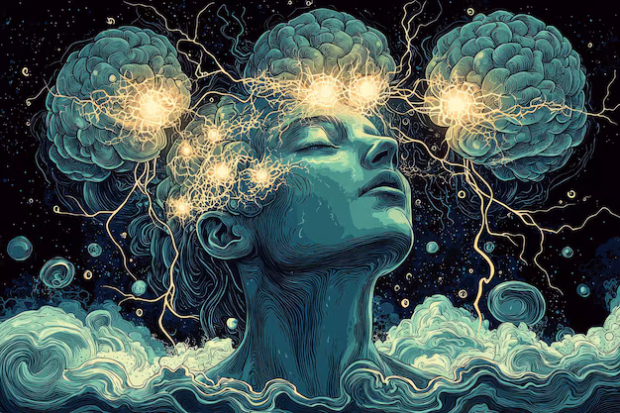
THERE ARE NO
WRONG FEELINGS
Exploring the nature of Human Emotions and the Philosophy of Māyā

Slide 2
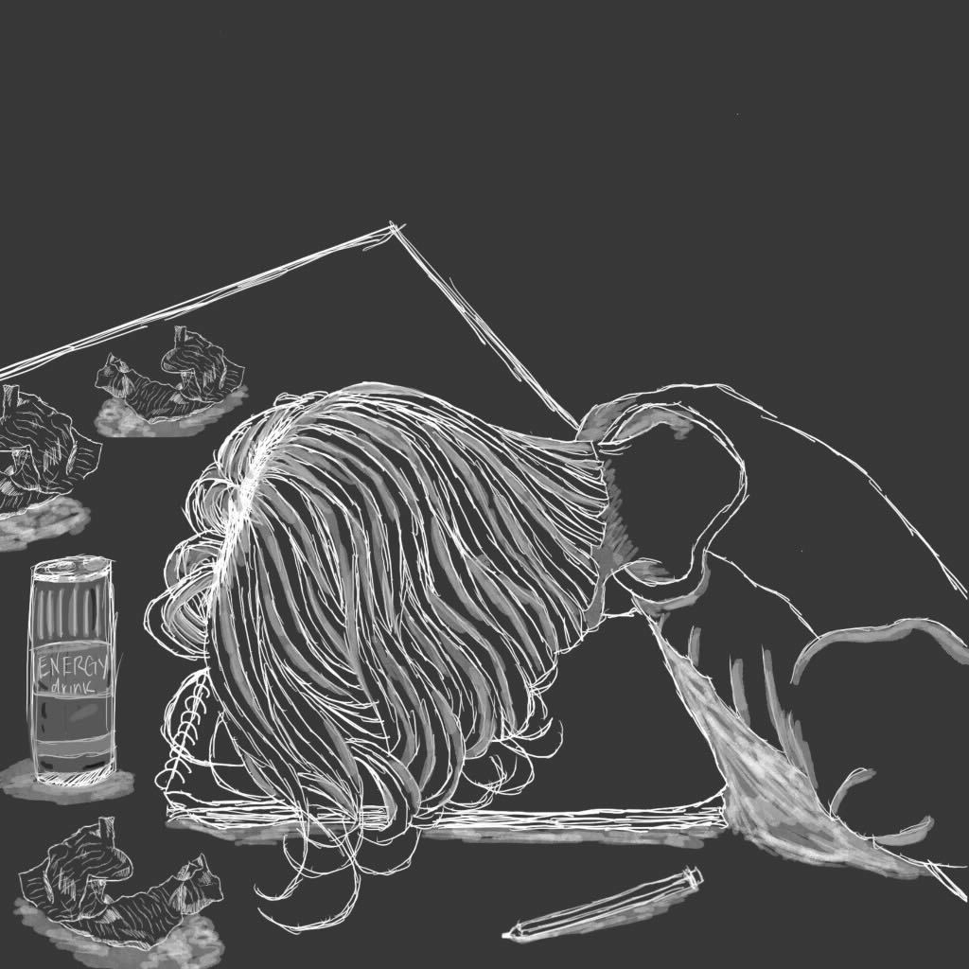
BAD
GOOD
Jealousy
Pride
Happiness
Greed
Confidence
Ambition
Hatred
Hope
Lust
Anger
Joy
Gratitude
Despair

Slide 3
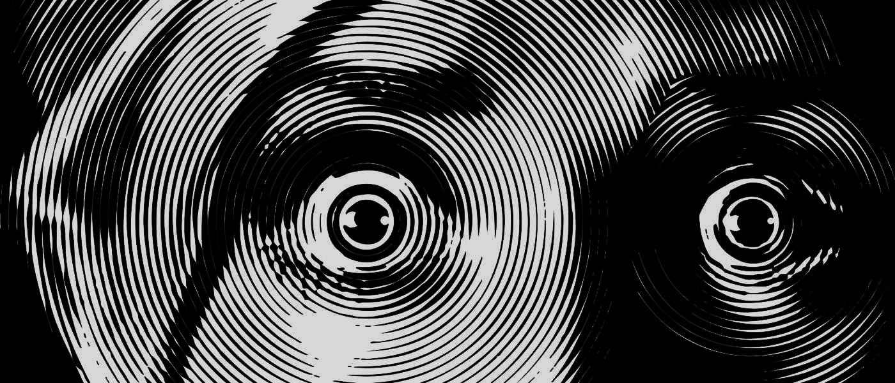
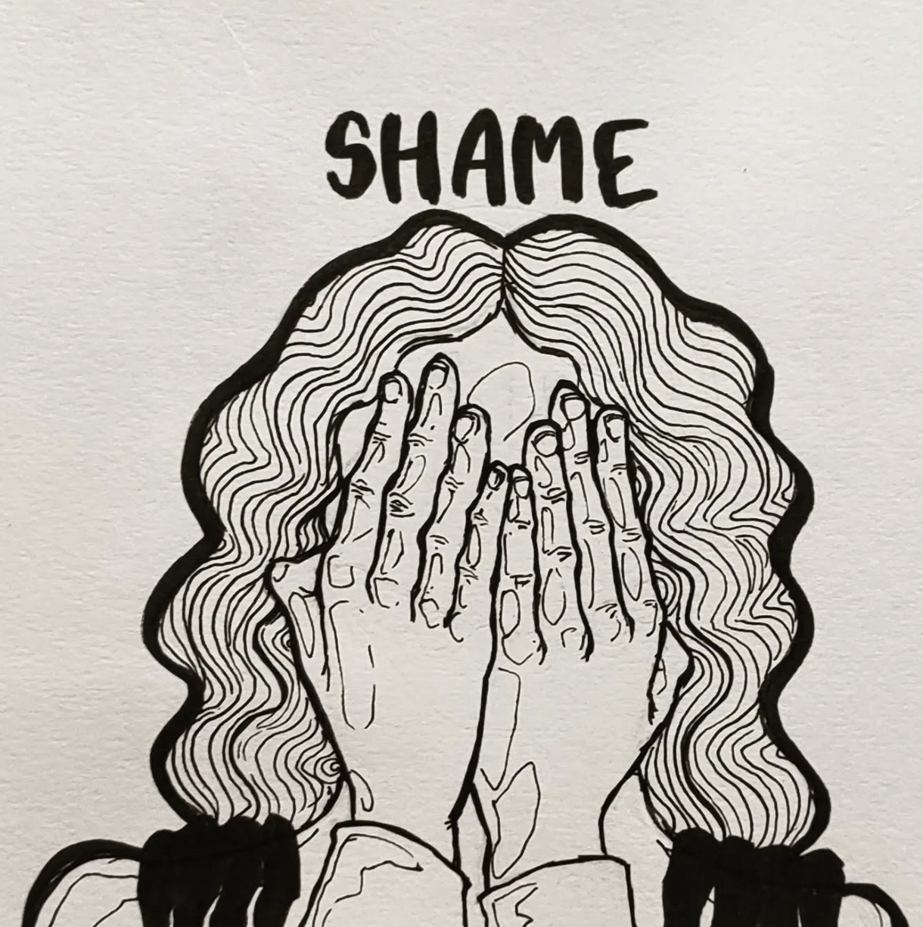
Why do we feel so much
?

Slide 4
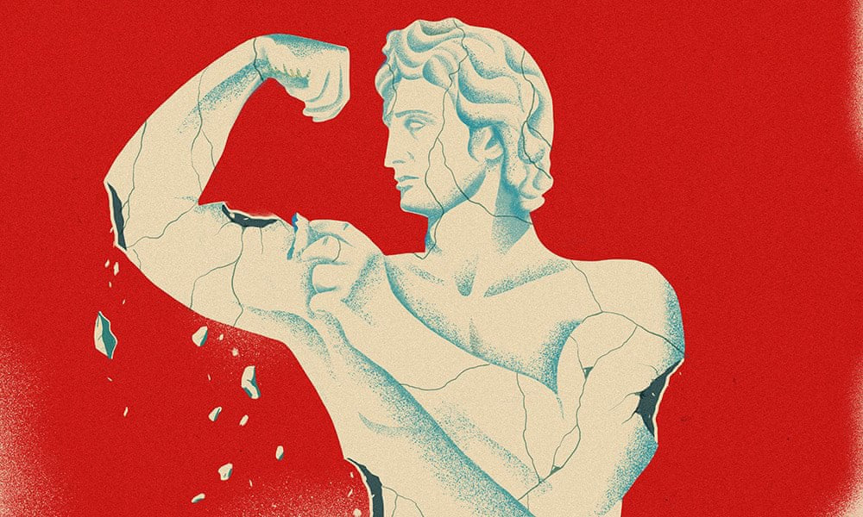

Society imposes a sense of shame associated with specific emotions. Men, for instance are openly discouraged from expressing any form of femininity.
“ Stop crying, you're acting like a girl, man up ”

Slide 5
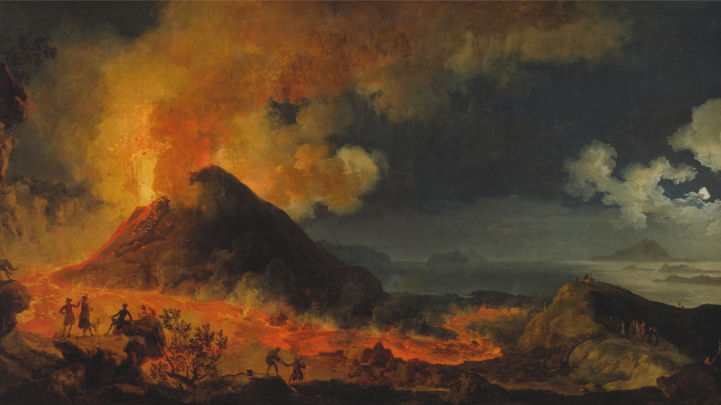
“
It is not the feeling of hatred that necessitates violence; it is the unacknowledged suppression of hatred that leads to destructive actions
”

Slide 6
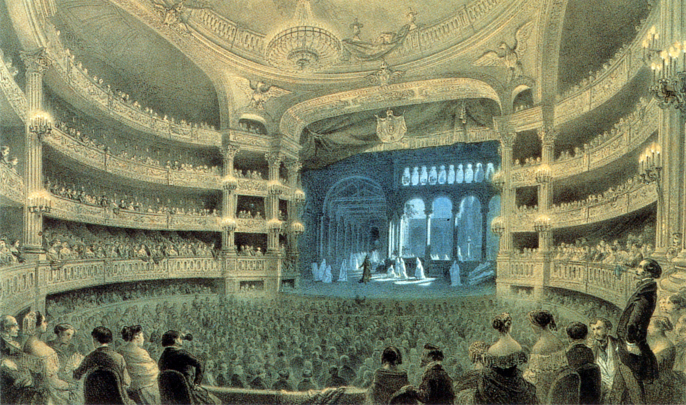
As actors of our own destiny, emotions are the script. In this way, human emotions relate deeply to life's grand drama. Anxiety and uncertainty, inherent elements of this cosmic performance, are not flaws but rather indicators of the play's success. It is like an enraptured audience member lost in the plot of a movie. The more reeled in you are the more they have succeeded as artists.

Slide 7

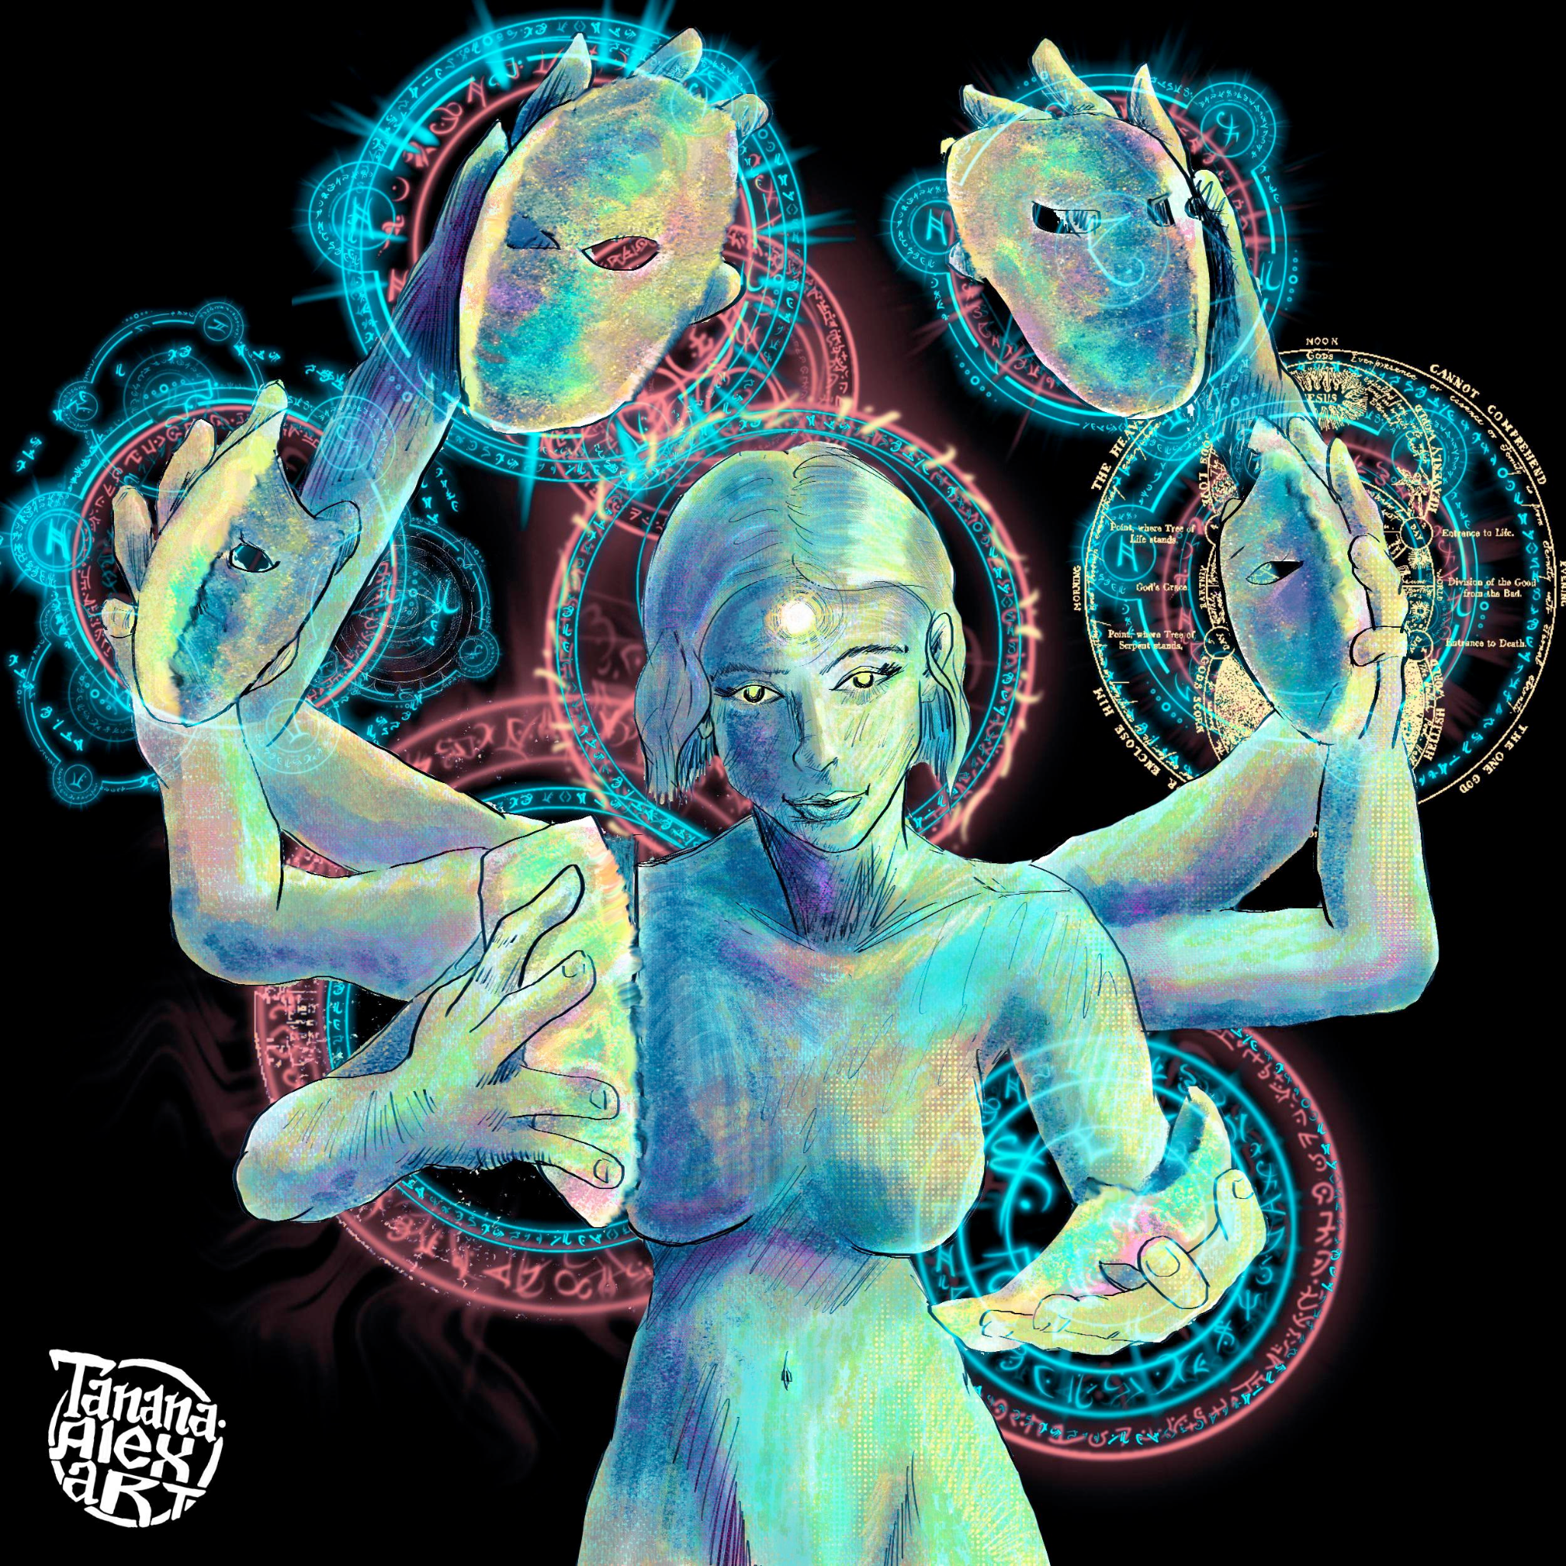
The Hindu philosophy of Māyā is a concept intricately connected to attachment in the Bhagavad Gita.
Māyā refers to the deceptive nature of the material world, which makes us perceive things differently from their true essence.

Slide 8
THANK YOU!

Slide 9
Research: Akash Adur, Diksha Kaushik, Emad Tariq ​
Design: Aryan Khare, Dalvin Thomas, Dhairya Bhanderi​
Presentation: Chitraksh Bhatia, Evani Menon​

